Slide 1
Client Side Scripting
Variables

Slide 2
Variables
Developers can hard code data in their JavaScript file but this would only make sense if the required information has been acquired before a user uses your website
This is generally the case for static website but not for dynamic websites
For example, you can make the string “Hi, Bob” appear in an alert box like this: alert('Hi, Bob'); But that statement only makes sense if everyone who visits the page is named Bob!
If you want to present a personalized message for different visitors, the name needs to be different depending on who is viewing the page: “Hi, Claire,” “Hi, Jamie,’’ “Hi, Mark,” etc
Fortunately, all programming languages provide a tool called a variable to deal with just this kind of situation
A variable is a way to store information so you can later use and manipulate it

Slide 3
Creating Variables Declaration
Before you can use a variable, you should declare its existence to the JavaScript engine using the var keyword.
This warns the engine that it needs to reserve some memory in which to store your data later.
To declare a new variable called myFirstVariable:
var myFirstVariable;
Note that the semicolon at the end of the line is not part of the variable name, but instead is used to indicate to JavaScript the end of a statement
Once declared, you can use a variable to store any type of data
This is because JavaScript is loosley typed unlike other languages where you would have also been required to declare the data type
The interpreter will deduce the type of data once the variable assignment is done

Slide 4
Creating Variables Assignment
Variable assignment is the process of putting data into your variables by using the equals (=)
myFirstVariable = 101;
In this situation, the equals is called the assignment operator
You can also create a variable and store a value in it with a single statement
var score = 0;
You can store strings, numbers, and Boolean values in a variable:
var firstName = 'Peter';
var lastName = 'Parker';
var age = 22; var isSuperHero = true;

Slide 5
Creating Variables Rules
What name you use is up to you, but there are a few rules you must follow when naming variables:
Variables must begin with a letter, $, or _. A variable can’t begin with a number or punctuation:
1thing and &thing - incorrect score $score and _score - correct
Variables can only contain letters, numbers, $, and _. You can’t use spaces or any other special characters anywhere in the variable:
fish&chips and fish and chips - incorrect fish_n_chips and plan9 - correct

Slide 6
Creating Variables Rules
Variable names are case-sensitive. The JavaScript interpreter sees uppercase and lowercase letters as distinct, so a variable named SCORE is different from a variables named score, sCoRE and Score
Avoid keywords. Some words in JavaScript are specific to the language itself: var, for example, is used to create a variable, so you can’t name a variable var. In addition, some words, like alert, document, and window, are considered special properties of the web browser. You’ll end up with a JavaScript error if you try to use those words as variable names
Naming variables according to the type of data makes it much easier to look at your programming code and immediately understand what’s going on
For example, score is a great name for a variable used to track a player’s game score

Slide 7
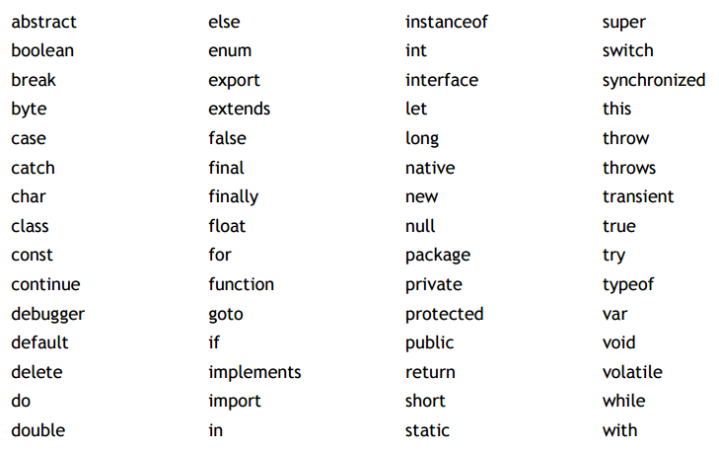
Some Reserved words

Slide 8
Constant Variables
The const keyword is used to declare a variable as constant: it’s value can never change during execution and remains constant
const pi = 3.14159;
var radius;
var area
Unlike variables declared with var:
Constant variables need to be inistialised (assigned for the 1st time) as soon as they are declared
Constant variables can never be reassigned to new values

Slide 9
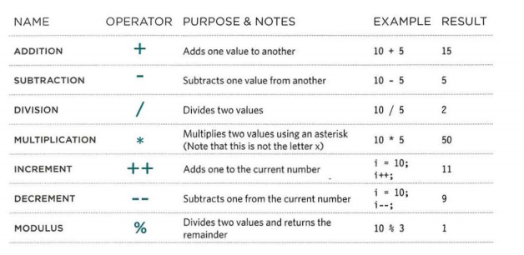
Useful Operators
We have already seen these basic operators:

Slide 10
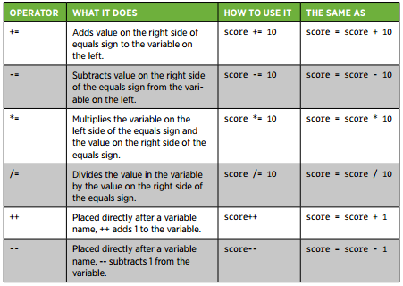
Useful Operators
These are other arithmetic operators which help in creating shortcuts:

Slide 11
The Environment
The collection of variables and their values that exist at a given time is called the environment
When a program starts up, this environment is not empty. It always contains a number of standard variables
When your browser loads a page, it creates a new environment and attaches these standard values to it. The variables created and modified by programs on that page survive until the browser goes to a new page
In a web application, each time a webpage is loaded into the browser, a new environment is created, and the old environment is destroyed
Any variables that you create are accessible until a new webpage is loaded

Slide 12
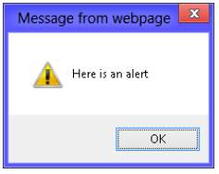
Built-in Functions alert
When writing web applications, the browser provides built-in functions that can present data to and collect data from the user:
alert: Used to display a message to the user in a window. The user clicks the OK button to close the message window.
The following code produces an alert window
alert('Here is an alert');

Slide 13
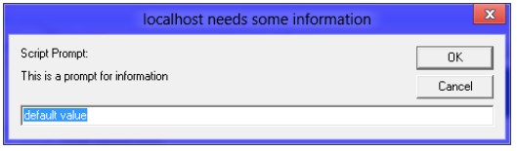
Built-in Functions prompt
prompt: Used to query the user for input by displaying a message prompt and a text box for the user to enter data into.
The text box can be supplied a default value that allows the user just to press Enter or click the OK button to accept the default value.
The user can close the window by clicking the OK or Cancel button.
The prompt function returns the data that the user typed in the text box.
The following code produces a prompt window
var promptResult = prompt('This is a prompt for information', 'default value');

Slide 14
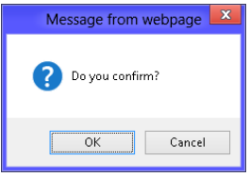
Built-in Functions confirm
confirm: Used to query the user for OK or Cancel by displaying a message window.
The user can close the window by clicking the OK or Cancel button.
The confirm function returns either true (when the OK button is clicked) or false (when the Cancel button is clicked):
var confirmResult = confirm('Do you confirm?');

Slide 15
Built-in Functions
These built-in functions, and any functions you write, can be overwritten very easily because the function name is a variable.
Consider the following scenario, in which a different function is assigned to the prompt function:
prompt = function(){
return 'hello again';
};
This code replaces the behavior of the prompt function with a function that always returns the string, ‘hello again’.
The function name is represented by a variable, and you can change its value dynamically.

Slide 16

Practice
Access Moodle and work out Worksheet 5

Slide 17
References
Johnson, G. (2013). Programming in HTML5 with Javascript and CSS3. United States of America: Microsoft Press.
McPeak, J. (2015). Beginning JavaScript, 5th Edition (5 ed.). Wrox.
Haverbeke, M. (2011). Eloquent JavaScript: A Modern Introduction to Programming. (S. Yang, Ed.) San Francisco: William Pollock.
McFarland, D. S. (2014). JavaScript & jQuery (3 ed.). United States of America: O’Reilly Media, Inc.

